Slide 1
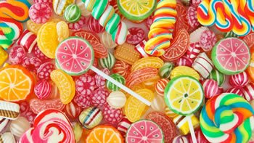
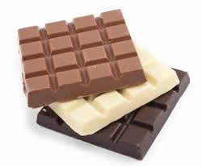
Machine Learning Foundation Project
Candy Data Analysis
Learner: Ulka Patil | Insaid: September 2019 Cohort

Slide 2
Table of Content
Introduction: Chocolate vs Candy
Relation of Chocolate, fruity and Win Percent
Relation of Caramel, Peanut/Almond and Win Percent
Relation of Nougat, Wafer and Win Percent
Relation of Hardness of Candy, Pluribus and Win Percent
Relation of Bar and Win Percent
Bivariate Analysis – Sugar, Price and Win Percent
Heat-map Correlation Between Features
TOP 10 Competitors: Ranking based on Win Percent
Interpretation of Trained Data
Final Analysis & Summary

Slide 3
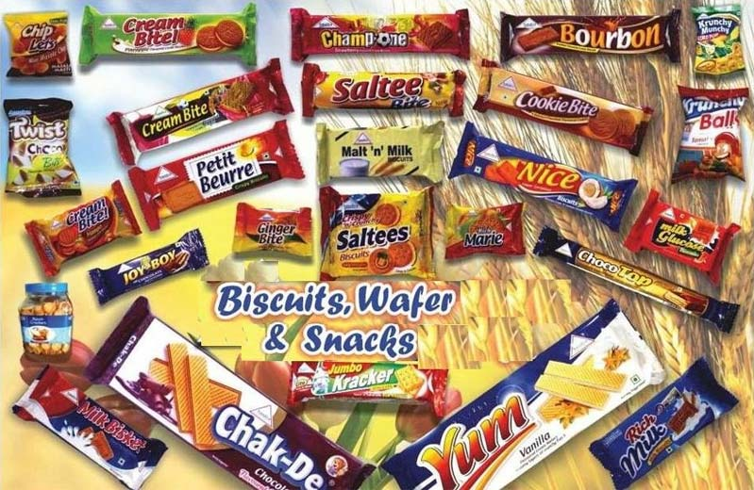
Introduction: Chocolate vs Candy
What’s the best (or at least the most popular) Halloween candy?
Which qualities are associated with higher rankings?
What’s the most popular candy? Least popular?

Slide 4
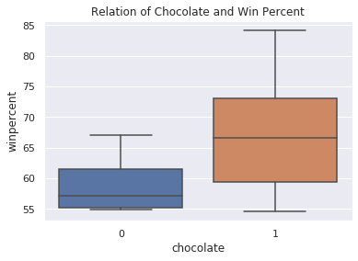
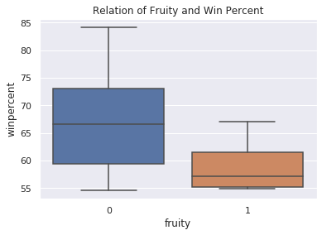
Relation of Chocolate and Win Percent
Relation of Fruity and Win Percent
Analysis:

Slide 5
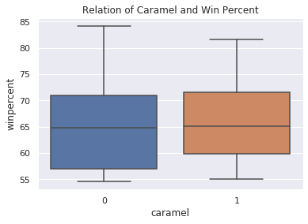
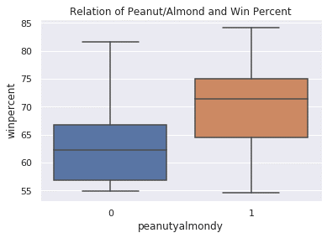
Relation of Caramel and Win Percent
Relation of Peanut/Almond and Win Percent
Analysis:

Slide 6
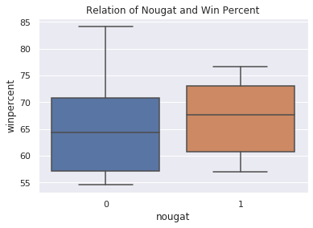
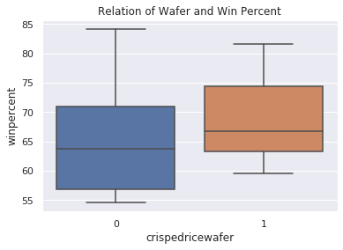
Relation of Nougat and Win Percent
Relation of Wafer and Win Percent
Analysis:

Slide 7
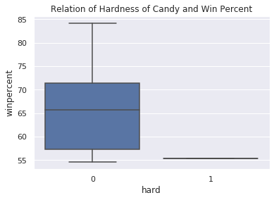
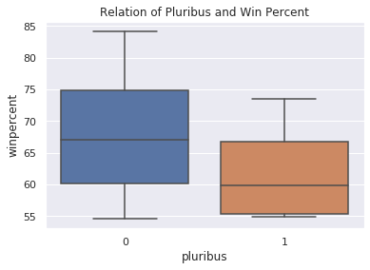
Relation of Hardness of Candy and Win Percent
Relation of Pluribus and Win Percent
Analysis:

Slide 8
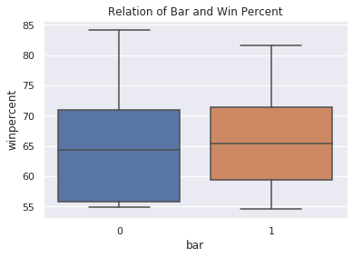
Relation of Bar and Win Percent
Conclusion:
>
>
>
Analysis:

Slide 9
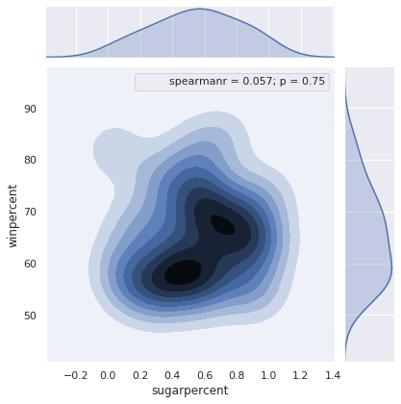
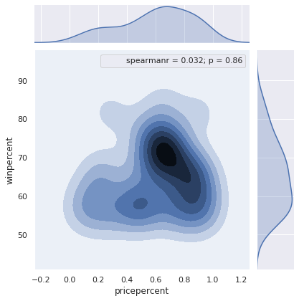
Bivariate Analysis
Sugar and Win Percent
Price and Win Percent

Slide 10
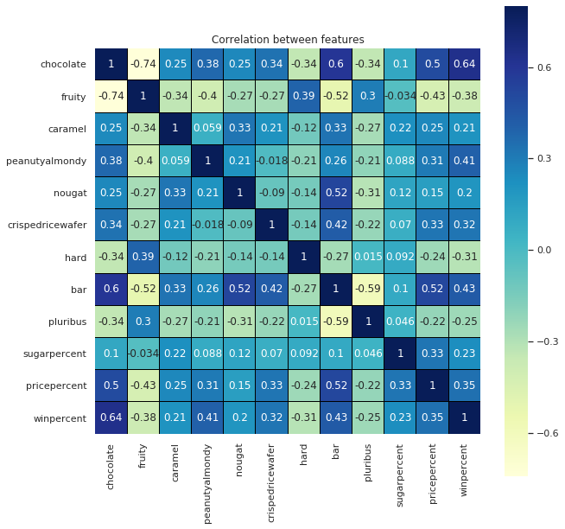
Heat-map Correlation Between Features

Slide 11
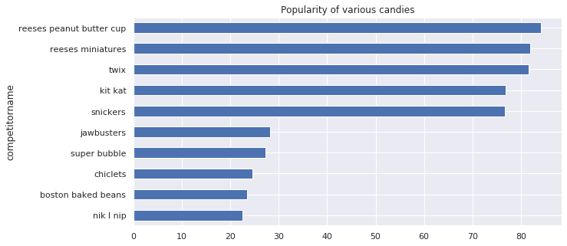
TOP 10 Competitors: Ranking based on Win Percent

Slide 12
Interpretation of Trained Data
Intercept: 34.13574296847616
Coefficients:
Chocolate = 18.92584064
Fruity = 8.05126009
Caramel = -3.58659701
Peanut and Almond = 8.45203415
Nougat = 7.93401708
Crisped Rice Wafer = 15.99830741
Hardness of Candy = -6.33077947
Bar= -4.73633764
Pluribus = -2.81719118
Sugar Percent = 11.43430413
Price Percent = -0.77170981

Slide 13
Final Analysis & Summary
Machine Learning Interpretation:
Using this data, we can estimate the combinations of the ingredient that can be a candy or a chocolate.
Using Win Percent we can figure out the top winners out of list of competitors.
Chocolate combinations of competitors are having higher Win Percent than a candy.
TBD

Slide 14
Thank You!

